Slide 1

project QUALITY
SOFTWARE ENGINEERING SPRINT 4

Slide 2

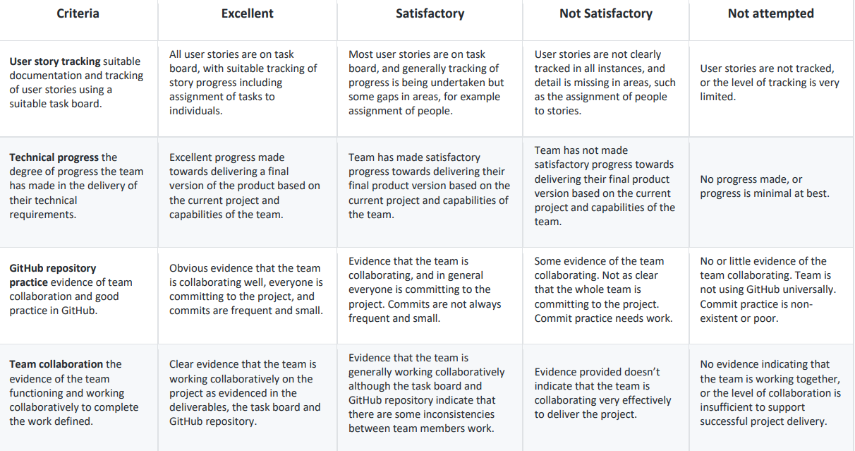
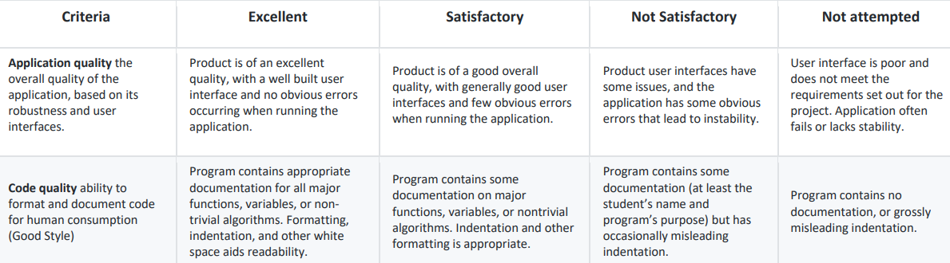

CRITERIA
The criteria we will be looking at is below:

Slide 3
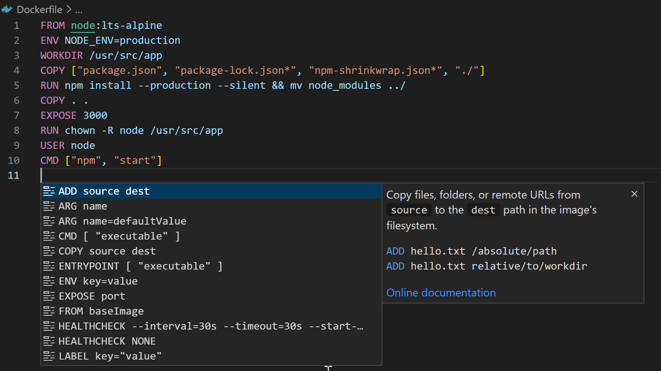
Code quality
The code for the software project is essential for tracking how team members are contributing and ensuring that the code is written in a clear and understandable way. Automated tests run whenever new code is added to check for any problems that could affect the existing functionality. Extensive unit tests are written to make sure that different parts of the code work correctly. If any issues or bugs are discovered, a system is in place to report and address them promptly. By following these steps, the software project can maintain high standards of functionality, reliability, and performance.

Slide 4
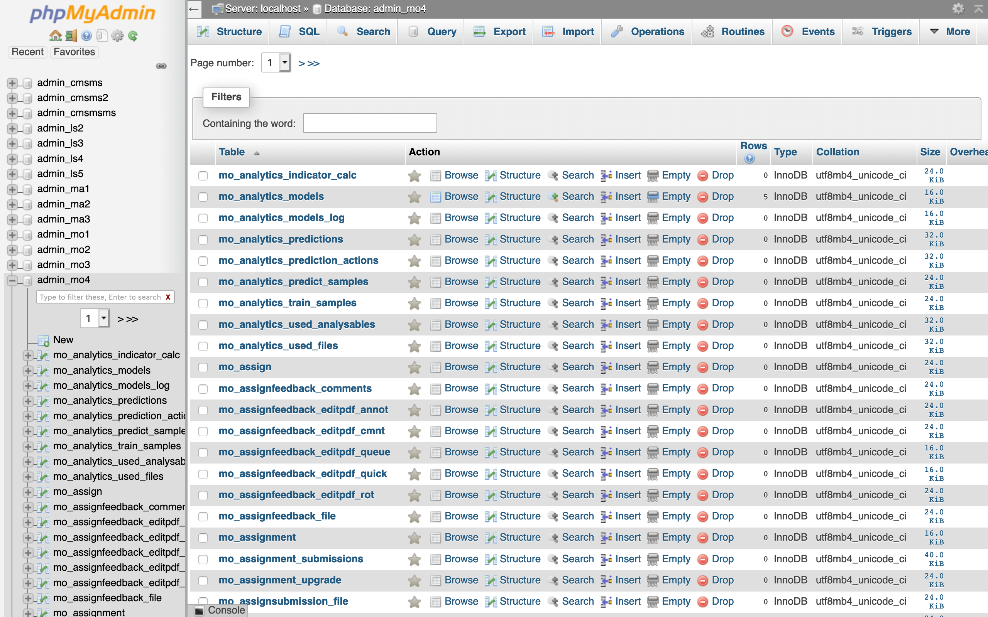
Application quality
The code is crucial for managing tasks related to the application and ensuring overall application quality. It guarantees that the application meets requirements, functions properly, and is user-friendly. The code also ensures successful deployment using a docker-compose file and meets all dependencies. It validates that the final version of the task board and project requirements are fulfilled, confirming that all project requirements and user stories are completed to achieve the application's intended purpose. The code effectively utilises Kanban/Project Board to track progress, assign tasks, and coordinate development efforts within the team. Ultimately, the code ensures that the application meets specified requirements, delivers expected functionality and features, and is easy to understand and use.

Slide 5
CODE FUNCTIONALITY
Scope Definition, Stakeholder Identification, and Risk Management are crucial aspects of the project's success. The scope defines what the project will deliver, ensuring it stays focused and achievable. By defining clear boundaries, the team can effectively plan and execute tasks within the given timeframe and resources. Stakeholder identification involves recognizing all parties involved in the project, including end-users and sponsors. Gathering feedback from stakeholders helps align the project with their needs and expectations, ensuring a successful outcome. Risk management involves identifying potential obstacles and developing strategies to address them. By anticipating challenges early on, the team can mitigate risks and prevent issues from derailing the project.
User Interface Design, Security Measures, and Scalability and Performance are essential for creating a reliable and user-friendly application. User interface design focuses on creating an intuitive and easy-to-use interface for the application. By using familiar design patterns and responsive layouts, users can navigate the application effortlessly. Security measures are implemented to protect sensitive data and prevent unauthorized access. Encryption and authentication mechanisms ensure that user information remains secure. Scalability and performance considerations ensure that the application can handle increased usage and data volume without compromising speed or reliability. Efficient database design and optimization techniques maximize performance, providing a seamless user experience even under high loads.

Slide 6
Team collaboration
TASK | ASSIGNED TO
Overall application quality and success at meeting the aims set out during the design process | Arron
Metrics from GitHub: used to assess individual contribution | Mustafa & Abdiwahab
Application deployable using a docker-compose file, data can be provided separately | Mohamed
Final version of the task board and project requirements | Nuyem
Bug reporting system set-up | Mustafa
Group report | Nuyem & Abdiwahab
We worked very productively as a team. Initially we set up tasks based on everyone's strengths and weaknesses. Depending on the difficulties of the tasks we swapped roles around or assigned more people to help with specific tasks.

